Slide 1
CI/CD with Github Actions

Slide 2
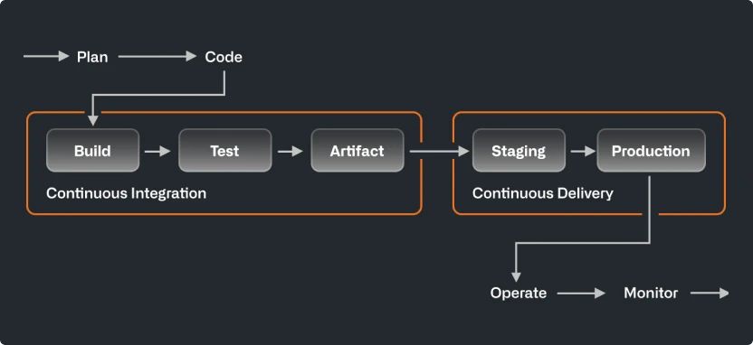
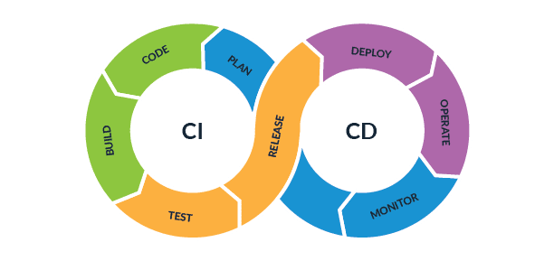
CI / CD – Continuous Integration & Continuous Deployment/Delivery
It's a set of practices and tools designed to improve the software development process by automating builds, testing, and deployment, enabling you to ship code changes faster and reliably.
Continuous Integration – Automatically builds, tests, and integrates code changes
Continuous Delivery – Deploy to production after manual approval
Continuous Deployment – Fully automated to production

Slide 3
GitHub Actions
GitHub Actions is a CI/CD tool provided by GitHub that allows us to automate workflows using YAML configuration files
The pipeline is defined inside a YAML file located in .github/workflows/
A typical workflow might include steps like:
Checking out code
Installing dependencies
Running tests
Building the app
Deploying to any service like Azure/AWS or any service

Slide 4
Docker & Kubernetes
Docker: Containerization Platform
Packages applications into containers, ensuring they run consistently across different environments
Docker Image is created using Docker File.
Docker File – contains instruction for building the source code.
Kubernetes: Container Orchestration
An open-source platform designed to automate the deployment, scaling, and management of containerized applications.
Pod: The basic unit that runs one or more containers.
Service: A stable way to expose an app and route traffic to changing Pods.
Deployment: A way to describe a desired app state and update it over time (often tied to rollouts and rollbacks).
Node: A machine in the cluster where Pods run.
Control plane: Components that manage cluster state and scheduling decisions.

Slide 5
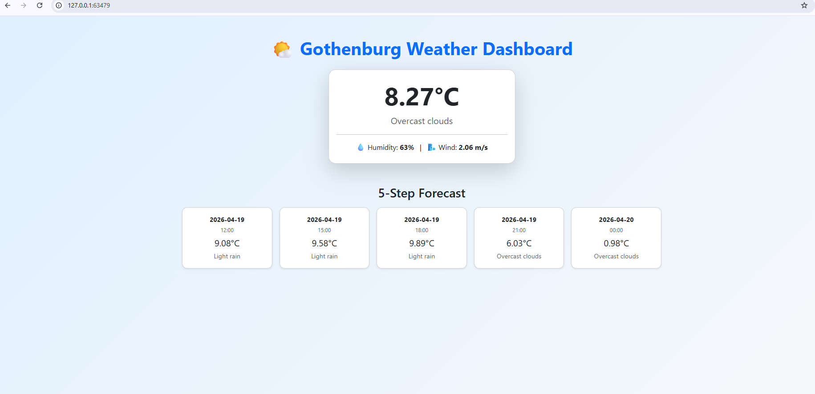
Screenshot of Weather App

